Slide 1
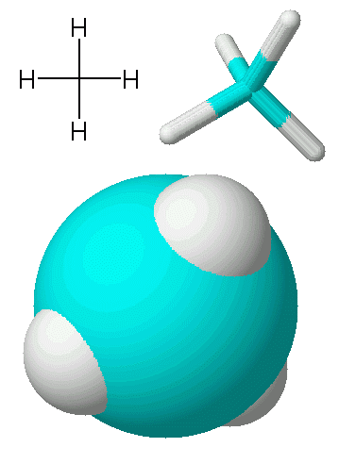
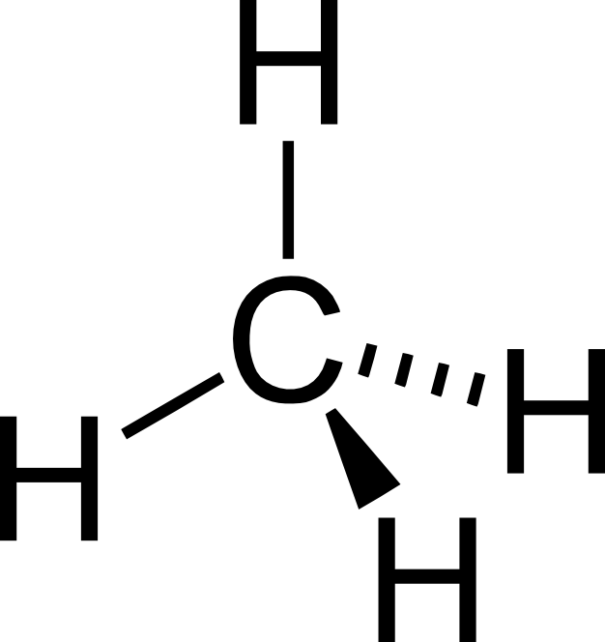
Covalent
Bonding
Bonding models for methane, CH₄. Models are NOT reality. Each has its own strengths and limitations.

Slide 2
CA Standards
Students know atoms combine to form molecules by sharing electrons to form covalent or metallic bonds or by exchanging electrons to form ionic bonds.
Students know chemical bonds between atoms in molecules such as H₂, CH₄, NH₃, H₂CCH₂, N₂, Cl₂, and many large biological molecules are covalent.
Students know how to draw Lewis dot structures.

Slide 3
The Octet Rule and
Covalent Compounds
Covalent compounds tend to form so that each atom, by sharing electrons, has an octet of electrons in its highest occupied energy level.
Covalent compounds involve atoms of nonmetals only.
The term “molecule” is used exclusively for covalent bonding

Slide 4
The Octet Rule:
The Diatomic Fluorine Molecule
F
1s
2s
2p
Each has seven valence electrons
F
1s
2s
2p
F
F

Slide 5
The Octet Rule:
The Diatomic Oxygen Molecule
O
1s
2s
2p
Each has six valence electrons
O
1s
2s
2p
O
O

Slide 6
The Octet Rule:
The Diatomic Nitrogen Molecule
N
1s
2s
2p
Each has five valence electrons
N
1s
2s
2p
N
N

Slide 7
Lewis Structures
Lewis structures show how valence electrons are arranged among atoms in a molecule.
Lewis structures Reflect the central idea that stability of a compound relates to noble gas electron configuration.
Shared electrons pairs are covalent bonds and can be represented by two dots (:) or by a single line ( - )

Slide 8
The HONC Rule
Hydrogen (and Halogens) form one covalent bond
Oxygen (and sulfur) form two covalent bonds
  One double bond, or two single bonds
Nitrogen (and phosphorus) form three covalent bonds
  One triple bond, or three single bonds, or one double bond and a single bond
Carbon (and silicon) form four covalent bonds.
  Two double bonds, or four single bonds, or a triple and a single, or a double and two singles

Slide 9
Completing a Lewis Structure -CH₃Cl
Make carbon the central atom (it wants the most bonds, 4)
Add up available valence electrons:
C = 4, H = (3)(1), Cl = 7 Total = 14
Join peripheral atoms
to the central atom with electron pairs.
H
..
..
..
..
H
..
C
Cl
..
..
Complete octets on
atoms other than hydrogen with remaining electrons
H

Slide 10
Bond Length and Bond Energy
Bond | Length (pm) | Energy (kJ/mol)
C - C | 154 | 346
C=C | 134 | 612
C≡C | 120 | 835
C - N | 147 | 305
C=N | 132 | 615
C≡N | 116 | 887
C - O | 143 | 358
C=O | 120 | 799
C≡O | 113 | 1072
N - N | 145 | 180
N=N | 125 | 418
N≡N | 110 | 942

Slide 11
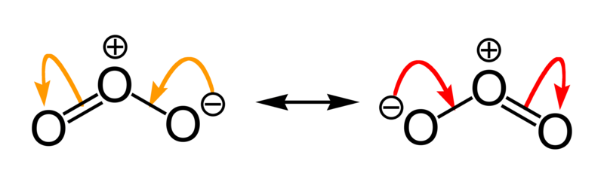
Resonance
Occurs when more than one valid Lewis structure can be written for a particular molecule.
These are resonance structures.
The actual structure is an average of
the resonance structures.

Slide 12
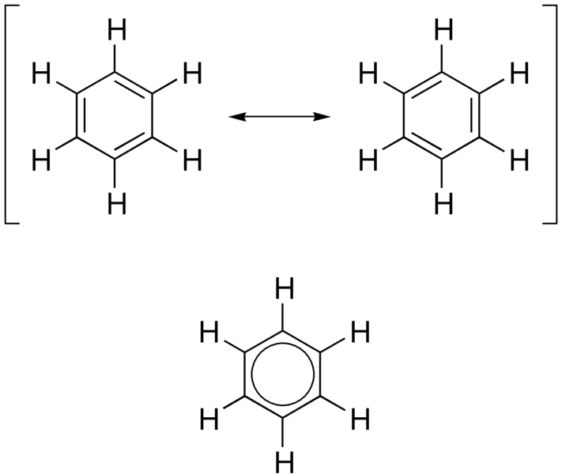
Resonance in Benzene, C₆H₆

